Slide 1
Emergency Preparedness
Education & Training Recommendations
NCAA Sports Science Institute(SSI)
Prepared by the College & University Athletic Trainers Committee

Slide 2
NCAA Sports Science Institute Education & Training Recommendations
Foundational information regarding EAP’s
Environmental monitoring (Lightning)
Head and neck injuries
Cardiac arrest
Heat illness and heatstroke
Exertional rhabdomyolysis
Exertional collapse associated with sickle cell trait
Any exertional or non-exertional collapse
Asthma
Diabetic emergency
Mental health emergency
Proper training principles/principles of periodization

Slide 3
Emergency Action Plans - Checklist
Name of the facility - Should be venue and event specific (practice vs competition)
Physical address, adjacent cross streets and GPS coordinates
An overhead photo/diagram of the facility with pertinent information and EAP Key
Venue Directions
EMS Access Point with Photo for reference
Emergency Personnel/ Communication (Name, Credentials, Sport, Phone #)
Description of Emergency Equipment location
Role of the first responders
Immediate care of the injured person
Activate EMS (call 911, provide pertinent information, notify campus police)
Retrieve emergency equipment
Direct EMS to scene
Scene control
The closest likely medical facility and the contact information (Hospital, Pharmacy, Urgent Care)
A description of the medical time out
The most recent revision date

Slide 4
Emergency Action Plans
Types of Emergencies
Head and neck injuries
Cardiac arrest
Heat Illness
Exertional Rhabdomyolysis
Exertional Sickling Event
Non-exertional collapse
Asthma
Diabetic
Mental Health Crisis
Roles in Emergency Action Plans
Immediate care of the person
Traditionally performed by medical staff
Activate EMS
One individual calls 911
Provide information
(location, telephone number, number of
injured persons, condition of injured, first
aid rendered, specific directions)
Second individual calls campus police
Designate individual to “flag down” EMS and direct to scene
Retrieve medical equipment
Direct EMS to the scene
Scene control (limit scene to those providing care)

Slide 5
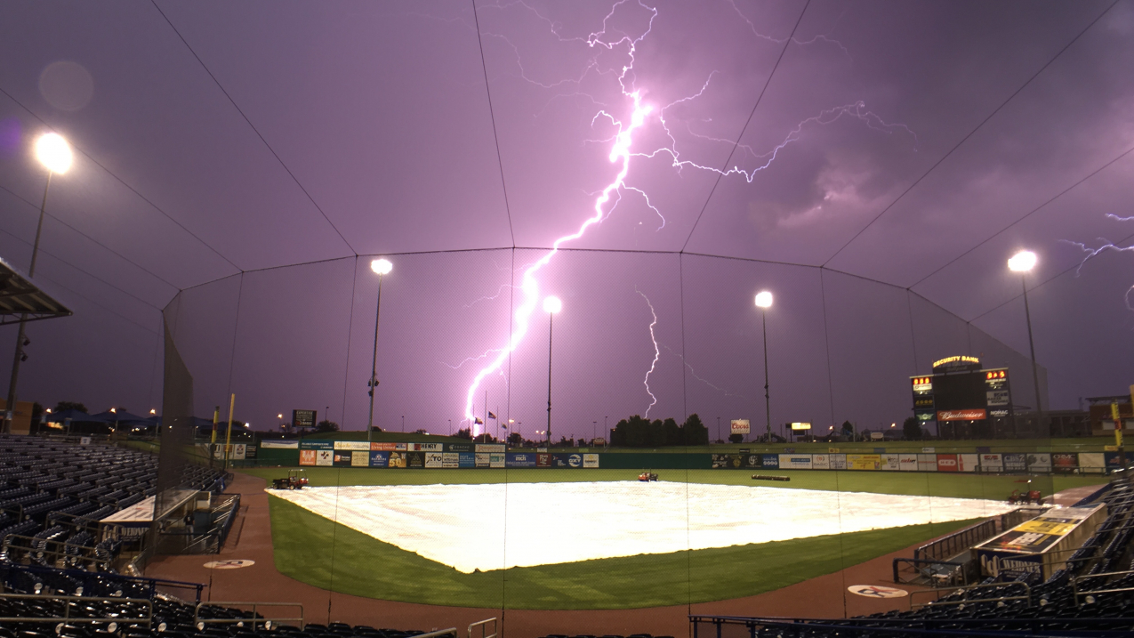
Lightning Policy
Education and Prevention are the keys to lightning safety
Develop a lightning safety plan for each outdoor venue
Current recommendations is to stop activity if lightning is within 8 miles of your outdoor venue
Designate a person to monitor threatening weather and to notify the chain of command who can make a decision to remove a team, game personnel, tv crews, and spectators from the athletics venue
Activities can resume if there is no lightning within 8 miles of your outdoor venue for at least 30 minutes
Monitor local weather reports daily
Know where the closest “safer structure or location” is to every outdoor venue and how long it will take to evacuate to that venue
Lightening awareness should be heightened at the first flash of lightning, clap of thunder, and/or other signs of an impending storm, such as increasing winds or darkening skies, no matter how far

Slide 6
Head and Neck Injury
Signs and Symptoms
Localized pain
Numbness
Tingling
Inability to move extremity
Loss of consciousness
Confusion
Nausea
Dizziness
What to do
Alert medical staff right away
If unavailable call 911
Stabilize head and neck
Cervical collars or immobilization devices can be applied
Do not move unless necessary to preserve life
If the person needs to vomit, roll head, neck and body as one unit to the side
Monitor for loss of movement or development of numbness
CPR may be necessary and if needed should be prioritized over head and neck injury.
If possible, keep head and neck stabilized during CPR
Special Attention
If sport equipment is present, staff will need to trained on proper removal procedure
Once EMS arrives transfer of care will be initiated. EMS will likely decide if patient will be spine boarded or if other transportation device will be used based on local procedures.

Slide 7
CARDIAC ARREST
Signs and Symptoms
Fatigue or weakness
Shortness of breath
Dizziness or lightheadedness
Heart palpitations
Chest discomfort
Sudden collapse
No pulse
No breathing
Convulsions
What to do
Alert medical staff right away
If unavailable call 911
If someone else is available, send them to retrieve AED
Place pads as quickly as possible
Check breathing and pulse
If trained, begin CPR
Continue CPR until person starts to breathe or medical staff arrive
Preparedness
Early use of an AED nearly doubles the chance of survival of a patient who is suffering a cardiac arrest. Having one available and accessible can make a big difference
Having all athletic staff and coaches CPR certified is encouraged

Slide 8
HEAT ILLNESS
Signs and symptoms
Heavy sweating
High core temperature > 103 ̊ F
Can only be obtained with rectal thermometry
Cold, pale and clammy skin (Heat exhaustion)
Hot, red, dry or damp skin (Heat stroke)
Fast pulse
Cramping
Head ache
Dizziness
Behavior change
Agitation and combativeness possible
Nausea
Fainting
Loss of consciousness
What to do
Alert medical staff right away
Move to a cool space
Important to reduce body temperature quickly
Cold submersion in ice tub best option
Do not hesitate
Activate the emergency plan if the medical staff are unavailable
Prevention
Having a cold water submersion option available during practices and games
Creating a heat policy for your institution to determine when it is safe to play outside
WetBulb Global Temperature (WBGT) is a common measure used to determine safety
Know which athletes have had heat illness in the past

Slide 9
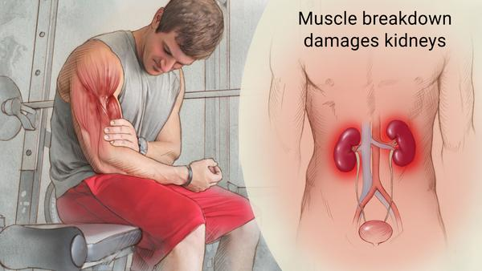
Exertional Rhabdomyolysis
Signs and Symptoms
Muscle weakness
Low urine output
Fatigue
Soreness
Bruising
Dark, tea colored urine
Infrequent urination
Fever
Nausea
Vomiting
Confusion
Agitation
What to Do
Remove from activity
Get fluids into the body
Activate emergency plan
Get athlete to hospital

Slide 10
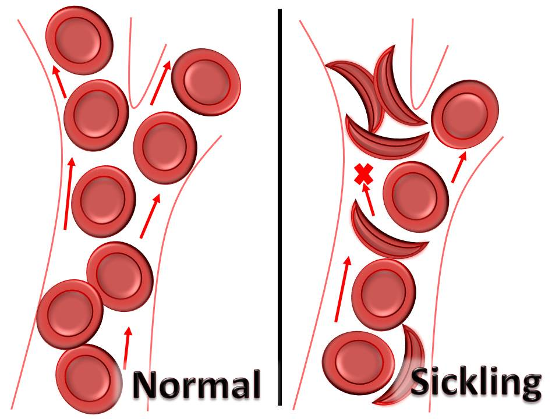
Exertional Sickling Event
*The NCAA requires that all student-athletes have a Sickle Cell solubility test as part of their preparticipation medical exam prior to any physical activity
Signs and Symptoms
Often confused with muscle cramping
Muscle pain
Muscle weakness
Slumping to ground instead of sudden collapse
Able to speak
Muscles look and feel normal (rule out heat cramps)
Rapid breathing without wheezing (rule out asthma)
Normal core temperature (rule out heat illness)
What to Do
Stop physical activity immediately
Remove from activity
Cool athlete if necessary
Administer Oxygen
Activate emergency plan
Inform hospital Sickling event and possible rhabdomyolysis

Slide 11
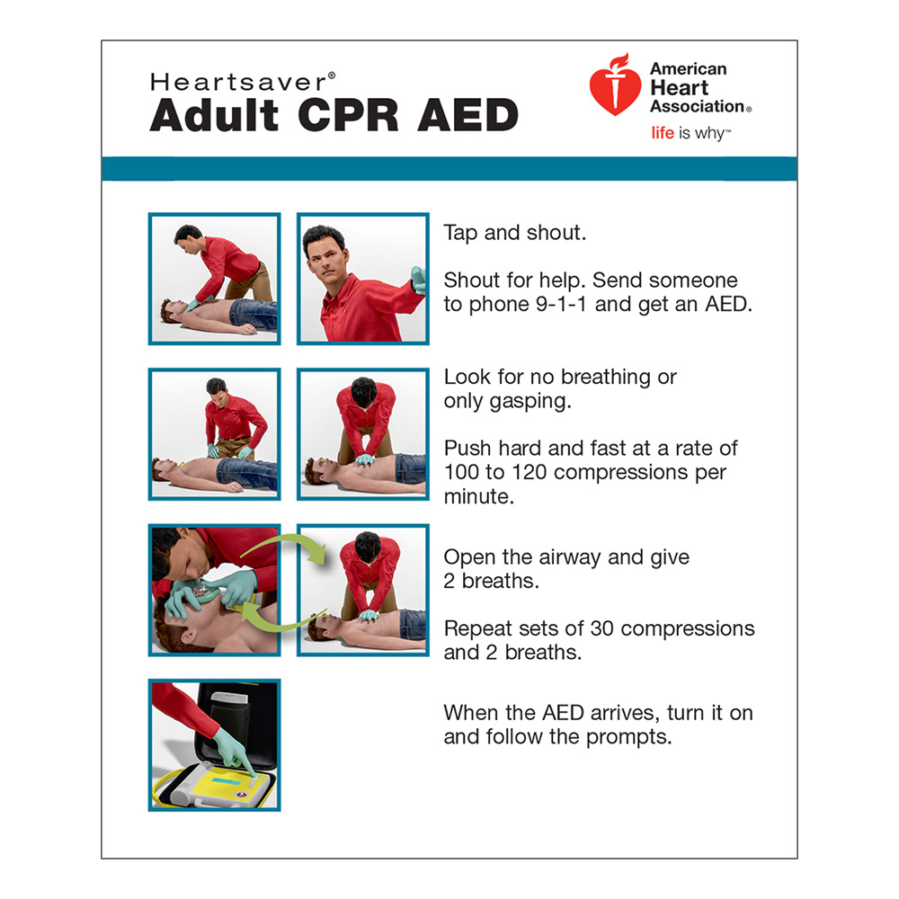
Collapsed Athlete
What to do
Check for consciousness
Check for breathing
Check for pulse
Call 911
If necessary, begin CPR

Slide 12
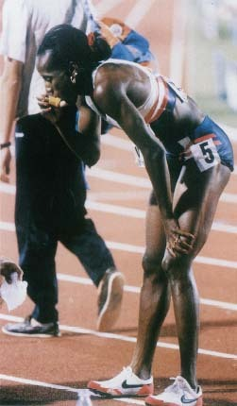
ASTHMA
Signs and Symptoms
Coughing
Wheezing
Trouble breathing
Chest tightness
Common Triggers
Air pollution
Animals
Mold
Smoke
Strenuous exercise
High humidity
Freezing temperatures
Strong emotional response
What to do
Help person sit in upright position
Loosen any clothing tight around neck
Help person use their personal inhaler
Take off cap
Person should breath out and close lips tightly around mouth piece
Press inhaler as person inhales slowly and hold breath for 10 seconds
Deliver 3 more puffs a minute apart
If symptoms persist, transport to Medical Facility

Slide 13
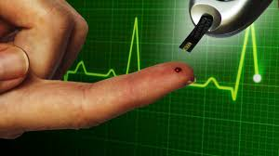
DIABETES
Hypoglycemia (low blood sugar)
Confusion
Blurred vision
Weakness
Slurred speech
Drowsiness
Seizure
Loss of consciousness
Ketoacidosis
Excessive thirst
Confusion
Blurred vision
Weakness
Nausea
Abdominal pain
Dry mouth or fruity scented breath
Deep, rapid breathing
What to do
For suspected HYPOGLYCEMIA give sugar based product
½ cup of juice or soda
1 tablespoon of honey
4-6 pieces of hard candy
3-4 glucose tablets
For suspected KETOACIDOSIS hydration is important

Slide 14
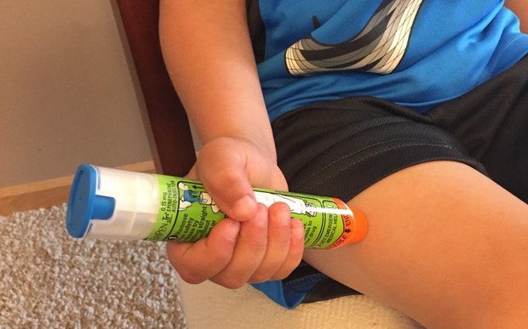
Anaphylactic Shock
Signs and Symptoms
Severe allergic reaction
Foods (nuts and shellfish common)
Latex (found in gloves and adhesive tapes)
Medications (including penicillin and aspirin)
Insect stings
Swelling of mouth
Difficulty breathing
Hives
Vomiting
Dizziness
Fainting
Rapid heartbeat
What to do
Call 911
Retrieve Epi-Pen from designated location
Assist person with applying the Epi-Pen to their thigh
Inject for 10 seconds
Give Epi-Pen to EMS upon arrival

Slide 15
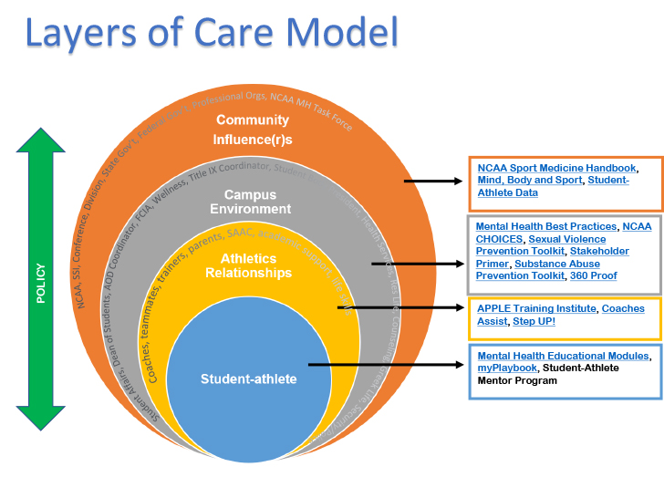
Mental Health Emergency
Clinical Licensure of Practitioners Providing Mental Health Care
Schools are encouraged to ensure that the mental health care of a college athlete is provided by a licensed individual who is qualified to provide mental health services
Identify critical mental health issues
Identify campus partners and resources
Identify evidence-based programs, policies and practices
Implementing programs, policies and practices
Evaluating the effectiveness of prevention efforts

Slide 16
Proper Training Principles &Periodization
Periodization
The planned manipulation of training variables (loads, sets, and repetitions) in order to maximize training adaptations and to prevent the onset of overtraining syndrome
Recommendations for Strength & Conditioning Coaches
Accredited by an oversight organization
Have at least an undergraduate college degree
Perform continuing education credits each year/reporting cycle
CPR and First Aid Certified
Are responsible for the periodization of your training
The Athlete’s Role in Safety
Report Injuries and Injuries to the Medical Staff
Alert Medical Staff of any medications or supplements you are taking
Perform off-season training as prescribed by the Strength & Conditioning Coach
Acclimatize progressively into your new training programs
Avoid the use of caffeine or other stimulants that can mask fatigue
Look out for yourself and your teammates

Slide 17
Resources
Mental Health Educational Resources
https://www.ncaa.org/sports/2016/8/4/mental-health-educational-resources.aspx
Inter-Association Consensus Document: Best Practices for Understanding and Supporting Student-Athlete Mental Wellness
https://ncaaorg.s3.amazonaws.com/ssi/mental/SSI_MentalHealthBestPractices.pdf
Resource Checklist for Mental Health Care
https://s3.amazonaws.com/ncaa.org/documents/2021/1/18/2018SSI_Mental_Health_Best_Practice_1_Checklist_20180606.pdf
Sample Mental Health Procedures
https://s3.amazonaws.com/ncaa.org/documents/2021/1/18/2018SSI_Mental_Health_Best_Practice_1_Checklist_20180601_pdf2018SSI_Sample_Mental_Health_Procedures_20180601.pdf
Mental Health Interdisciplinary Team Planner
https://s3.amazonaws.com/ncaa.org/documents/2021/1/18/2018SSI_Mental_Health_Interdisciplinary_Planner_20180601.pdf
Inclement/Hazardous Weather
https://www.ncaa.org/sports/2017/1/13/inclement-hazardous-weather.aspx
Interassociation Consensus Statement on Cardiovascular Care of College Student-Athletes
https://www.jacc.org/doi/10.1016/j.jacc.2016.03.527?articleid=2513587&#tab1
Cardiac Care Best Practices
https://ncaaorg.s3.amazonaws.com/ssi/cardiac/SSI_CardioCareCheck.pdf
ACSM and NCAA Joint Statement – Sickle Cell Trait and Exercise
https://www.ncaa.org/sports/2013/12/18/acsm-and-ncaa-joint-statement-sickle-cell-trait-and-exercise.aspx
Sickle Cell Trait Fact Sheet for Coaches
https://ncaaorg.s3.amazonaws.com/ssi/other/SSI_NCAASickleCellTraitforCoaches.pdf
Sickle Cell Trait Fact Sheet for Student-Athletes
https://ncaaorg.s3.amazonaws.com/ssi/other/SSI_NCAASickleCellTraitforSA.pdf
NCAA Sports Science Institute Lightning Safety
https://www.ncaa.org/sports/2014/4/9/lightning-safety.aspx

